Slide 1

Botnet Detection in Network Traffic
BY Hemachandrarao Movva

Slide 2
BUSINESS UNDERSTANDING
Objective:
The primary objective of the Business Understanding phase is to identify the business goals and translate them into a clear data mining problem. In the context of botnet detection in network traffic, the aim is to develop a model capable of identifying malicious activities (i.e., botnet traffic) in a network environment. This model will help businesses, such as cybersecurity firms or IT departments, in detecting potential threats, minimizing risks, and maintaining the security and integrity of their network infrastructure.

Slide 3
BUSINESS UNDERSTANDING
Business Goals:
Prevent Cybersecurity Breaches: Detect botnet infections early to protect business assets and sensitive data.
Optimize Network Performance: Reduce malicious traffic to enhance network efficiency for legitimate users.
Enable Real-time Threat Detection: Implement real-time monitoring to classify and respond to botnet activity instantly.

Slide 4
BUSINESS UNDERSTANDING
Current Situation:
Traditional Methods: Signature-based and manual detection methods struggle with advanced botnets.
Machine Learning Need: ML algorithms can analyse large datasets to detect new, complex botnet behaviours.
Dataset Overview: The UNSW_NB15 dataset includes 82,332 records with 45 features for network traffic classification.

Slide 5
BUSINESS UNDERSTANDING
Potential Risks:
Class Imbalance: Address imbalanced data with oversampling, under sampling, or weighted loss functions.
Data Quality: Ensure clean data by handling errors, missing values, and irrelevant features.
Model Generalization: Use cross-validation and regularization to prevent overfitting and improve model robustness.

Slide 6
DATA UNDERSTANING
Objective:
The objective of the Data Understanding phase is to collect and familiarize ourselves with the data, gain insights into its quality, identify any issues, and understand its characteristics. This step is crucial for determining the suitability of the data for the modelling phase and ensuring it aligns with the business problem.

Slide 7
DATA UNDERSTANING
Data Collection: The dataset used in this project is the UNSW_NB15_training-set 1.csv, which consists of 82,332 records and 45 columns.
Initial Data Analysis: The first few rows of the data have been examined using df. head (). This step provides a snapshot of the data and helps understand the types of features present, such as id, dur, proto, service, state, and network traffic statistics like spkts, dpkts, sbytes, dbytes, etc.

Slide 8
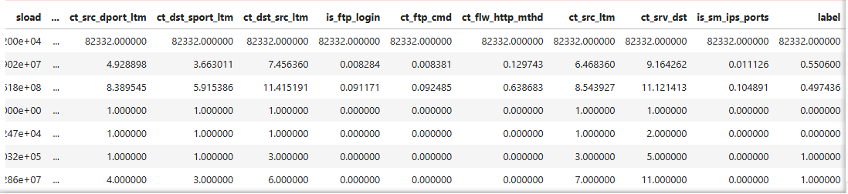
DATA UNDERSTANING
Data Description:
Shape: 82,332 rows, 45 columns (numeric & categorical features).
Summary Statistics: Key stats (mean, std, min, max) from df.describe().
Correlation Matrix: Analyzed feature correlations to identify potential model impact.

Slide 9
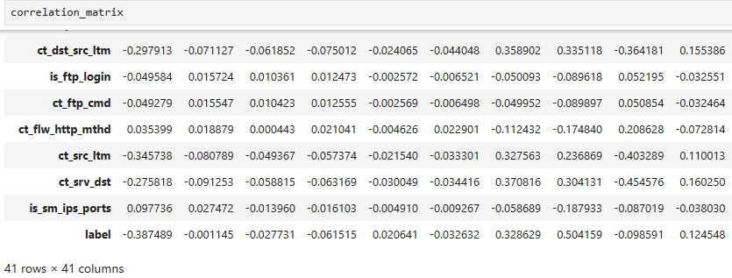
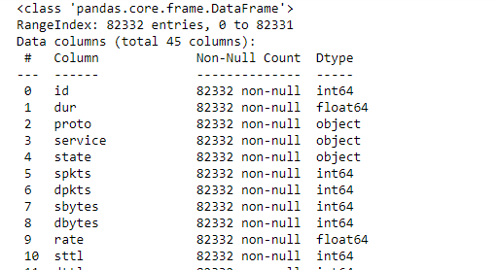
DATA UNDERSTANING

Slide 10
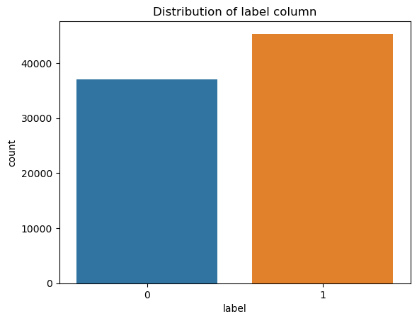
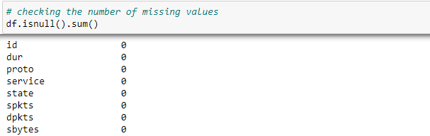
DATA UNDERSTANING
Data Quality Check:
Missing Values: No missing values (df.isnull().sum() confirms).
Data Types: Categorical (e.g., proto, service) and numerical (e.g., dur, spkts).
Target Distribution: 45,332 abnormal (1) vs. 37,000 normal (0) traffic instances, highlighting class imbalance.

Slide 11
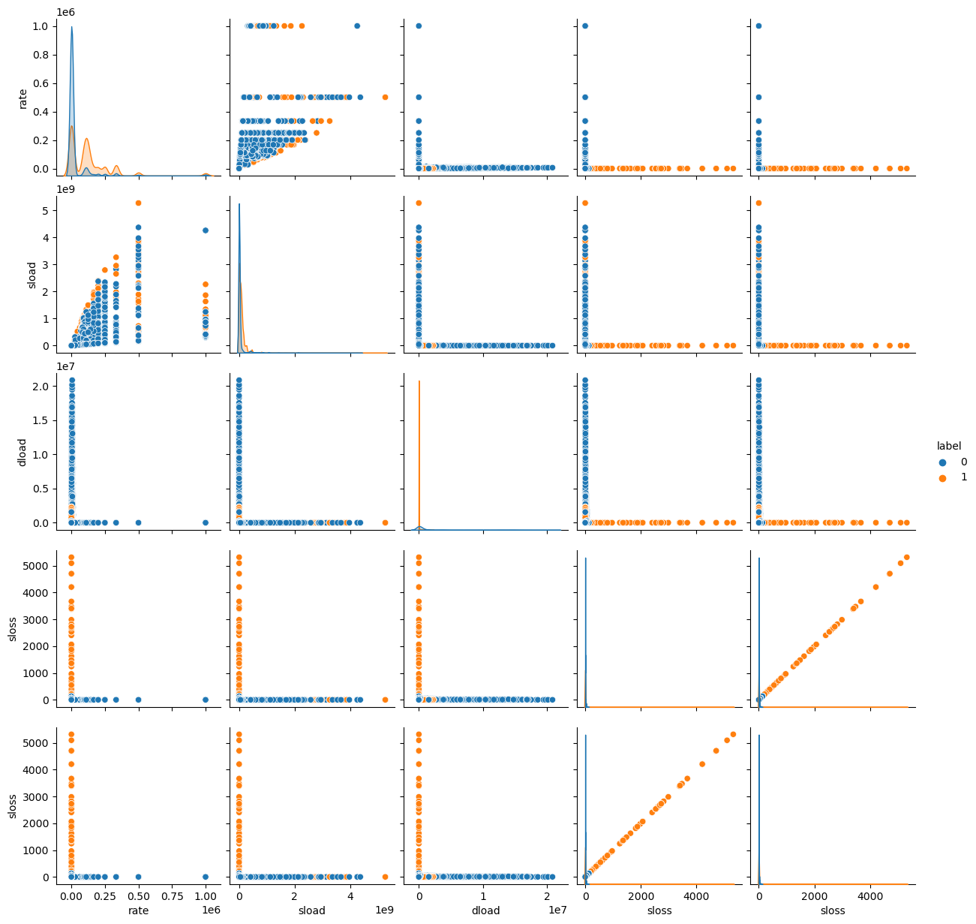
DATA UNDERSTANING
Exploratory Data Analysis (EDA):Statistical Summary:
Statistical Summary: Examined key variables like rate, sload, dload, and sloos .
Pairplot: Visualized feature relationships with the target variable to identify patterns

Slide 12
DATA PREPARATION
Objective:
The goal of the Data Preparation phase is to ensure that the dataset is clean, well-structured, and ready for the modelling phase. This involves handling missing values, encoding categorical variables, transforming data into suitable formats, and selecting the most relevant features for the learning task.

Slide 13
DATA PREPARATION
Key Tasks in Data Preparation :
Data Cleaning:
Handling Missing Values: Imputed missing values with the column mean.
Removing Duplicates: Checked and removed duplicate entries
.Outlier Detection: Used IQR or Z-scores to identify and handle outliers.
Data Transformation:
Encoding Categorical Variables: Used label encoding for categorical data.Feature Scaling: Applied MinMaxScaler to scale numerical features between 0 and 1.

Slide 14
DATA PREPARATION
Handling Imbalanced Data:
Recommended techniques like class weighting, oversampling, or undersampling.
Data Splitting:
Used train_test_split to divide the dataset into training and testing sets for model evaluation.
Feature Selection:
Removing Irrelevant Features: Excluded the target variable new_label from the feature set.
Selecting Important Features: Used correlation analysis to reduce multicollinearity.
Data Integration:
Integrated data from multiple sources when necessary for a unified dataset.

Slide 15
DATA MODELING
MODELING
objective:
The primary goal in model selection was to identify a machine learning algorithm that could deliver high accuracy while efficiently handling complex data structures, class imbalances, and potential overfitting. Given the critical nature of accurate classification, the focus was on an algorithm that could adapt well to varied data distributions and ensure robust generalization.
RESULTS FROM RAPID MINNER
Model Comparison Based on F1-measure
MODEL | F1-Measure | Standard Deviation | Gains | Total Time | Training Time | Scoring Time
Naive Bayes | 0.728595 | 0.006525 | 1720 | 7475 | 10.2 | 678.25
Generalized Linear Model | 0.824688 | 0.006947 | 3312 | 6676 | 86.15 | 257.875
Logistic Regression | 0.800867 | 0.004927 | 2876 | 5316 | 30.65 | 378.875
Deep Learning | 0.799974 | 0.005589 | 2860 | 22540 | 535.6 | 326.5
Decision Tree | 0.652262 | 0.003095 | -16 | 6064 | 14.05 | 297
Random Forest | 0.807755 | 0.008232 | 3354 | 107531 | 71.9 | 597
Gradient Boosted Trees | 0.803721 | 0.007943 | 3490 | 112912 | 353.6 | 695
Support Vector Machine | 0.666667 | 5.19E-04 | 0 | 3075279 | 40138.27 | 25779.83

Slide 16
DATA MODELING
Model Comparison Based on Precision
MODEL | Precision | Standard Deviation | Gains | Total Time | Training Time | Scoring Time
Naive Bayes | 0.59581 | 0.009018 | 1720 | 7475 | 10.2 | 678.25
Generalized Linear Model | 0.707528 | 0.009975 | 3312 | 6676 | 86.15 | 257.875
Logistic Regression | 0.668517 | 0.00663 | 2876 | 5316 | 30.65 | 378.875
Deep Learning | 0.667278 | 0.007429 | 2860 | 22540 | 535.6 | 326.5
Decision Tree | 0.499266 | 0.002505 | -16 | 6064 | 14.05 | 297
Random Forest | 0.755649 | 0.009986 | 3354 | 107531 | 71.9 | 597
Gradient Boosted Trees | 0.810719 | 0.010124 | 3490 | 112912 | 353.6 | 695
Support Vector Machine | 0.5 | 5.83E-04 | 0 | 3075279 | 40138.27 | 25779.83

Slide 17
DATA MODELING
Modal Comparison Table (Recall)
Model | Recall | Standard Deviation | Gain | Total Time | Training Time | Scoring Time
Naive Bayes | 0.9377230475304031 | 0.009192 | 1720 | 7475 | 10.200000000000001 | 678.25
Generalize Linear Model | 0.98844990386 | 0.004565 | 3312 | 6676 | 86.15 | 257.875
Logistic Regression | 0.998600173906 | 7.82528072803459 | 2876 | - | 30.65 | 378.875
Deep Learning | 0.998599561559 | 0.001465 | 2860 | 22540 | 535.5999999 | 326.5
Decision Tree | 0.9405000428643161 | 0.00809 | -16 | 6064 | 14.05 | 297
Random Forest | 0.867689490894 | 0.01170401216198 | 3354 | 107531 | 71.9 | 597
Gradient Boosted Trees | 0.7969890879698236 | 0.013173 | 3490 | 112912 | 353.6 | 695
Support Vector Machine | 1 | 0 | 0 | 3075279 | 40138.26666666667 | 25779.833333333332

Slide 18
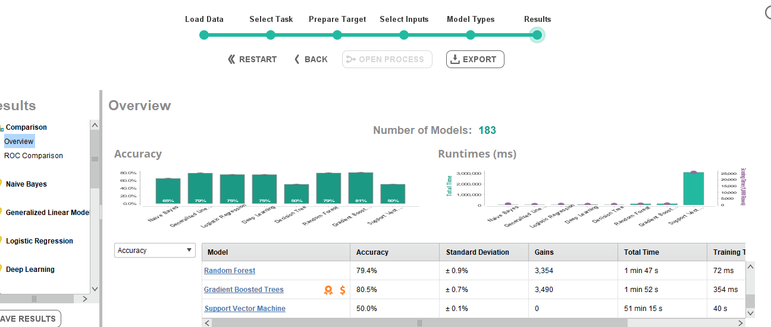
DATA MODELING
ACCURACY COMPARISON
Conclusion:
In the accuracy comparison of various machine learning models, Gradient Boosted Trees emerged as the best-performing model, achieving an impressive accuracy of 80.5%, highlighting its ability to effectively capture complex patterns in the data. Random Forest, while slightly less effective, achieved a respectable accuracy of 70%, demonstrating its robustness in handling large datasets and reducing overfitting. However, Support Vector Machine (SVM) performed poorly, with an accuracy of only 50%, indicating its struggles in accurately classifying the data in this scenario. Despite SVM's theoretical potential for high accuracy, its performance here underscores the importance of model selection based on the specific characteristics of the dataset. Overall, Gradient Boosted Trees proved to be the most reliable choice in terms of accuracy, outperforming other models significantly.

Slide 19
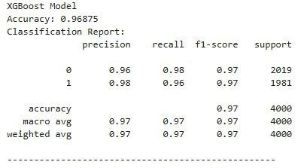
EVALUATION
EVALUATION
Accuracy measures the proportion of correct predictions in classification tasks. The XGBoost model achieved a high accuracy of 96.85% on the test dataset, indicating effective pattern recognition. However, in imbalanced datasets, accuracy may be insufficient, so precision, recall, and F1-score were also assessed for a more comprehensive evaluation of model performance..

Slide 20
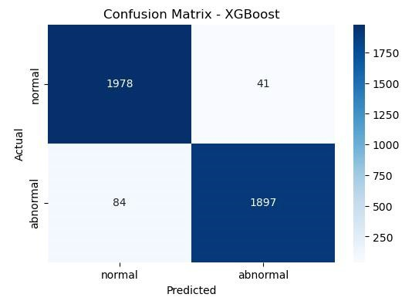
EVALUATION
Confusion Matrix Analysis
A confusion matrix was generated to provide a detailed breakdown of the model's predictions. The matrix revealed that the model correctly classified 97% of normal instances and 96% of abnormal instances. The small number of misclassifications suggests that the model effectively differentiates between the two classes, and there is no significant bias toward either class. This balanced performance indicates that the model is suitable for applications where distinguishing between normal and abnormal instances is critical.

Slide 21
Deployment
Deployment
Objective:
Deploy the trained XGBoost model for real-time decision-making, ensuring it is accessible to end-users or automated systems.
Deployment Plan:
Real-Time Data Ingestion: Connect the model to a data pipeline for continuous input (e.g., network traffic).Data Processing: Apply preprocessing (scaling, normalization) consistent with training.
Real-Time Predictions:
Deploy the model via an API (Flask, FastAPI, etc.) for instant predictions on incoming data.

Slide 22
Deployment
Documentation:
Model Documentation: Details on preprocessing, features, hyperparameters, and performance metrics.
API Documentation: Guidelines for using the API, including input/output formats and examples.
Version Control: Track updates and improvements systematically.
Monitoring and Maintenance:
Model Monitoring: Regularly check for data drift and performance degradation using tools like Prometheus or Grafana.
Real-Time Monitoring: Use dashboards to track inputs, outputs, and anomalies.
Model Updates: Implement updates seamlessly to maintain accuracy and business alignment

Slide 23

Thank You

